Slide 1

SERVERLESS COMPUTING
- MANSOUREH LORD & KARTHIKA DHARMIA RAJENDRAN

Slide 2
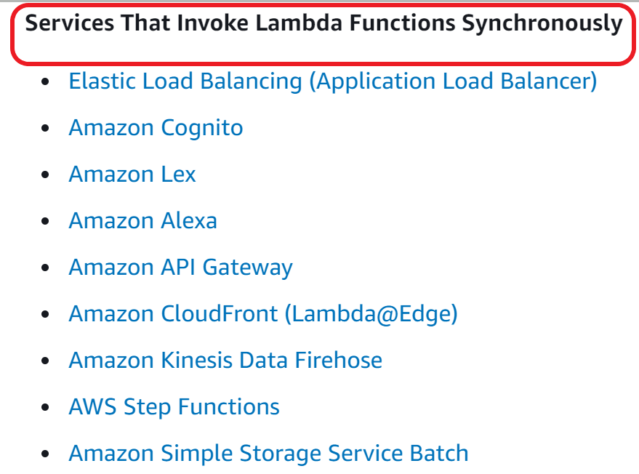
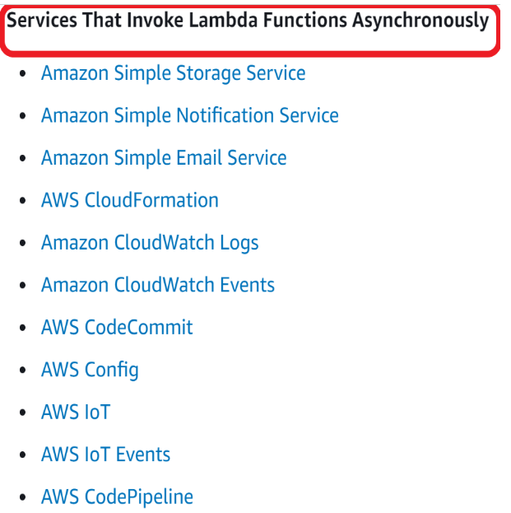
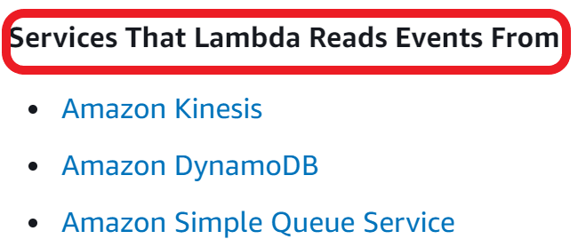
AWS Management Console
◼ Lambda Function
Choose runtime and required IAM policy as role.

Slide 3
Seminar 2
Using GitLab CI/CD Pipeline to deploy AWS SAM applications.
Deployment Automation of Serverless applications using Terraform and GitLab.
Serverless-Sagemaker-Orchestration demo.
Serverless Optimization techniques.
How to handle API Gateway timeout issue?
What does other cloud vendors provide?

Slide 4
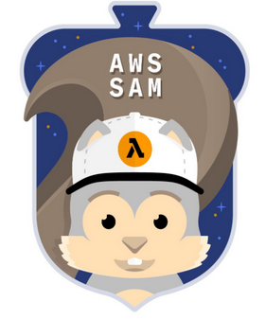
AWS Serverless Application Model
Open source framework for building serverless applications.
CloudFormation extension optimised for serverless application development.
Includes the AWS SAM Template Specification and AWS SAM Command Line Interface (CLI).
Supports anything CloudFormation supports - mix canonical CloudFormation and SAM together in the same template.
Provides convenient and concise syntax to express functions, APIs, databases, and event source mapping when compared to typical CloudFormation template.

Slide 5
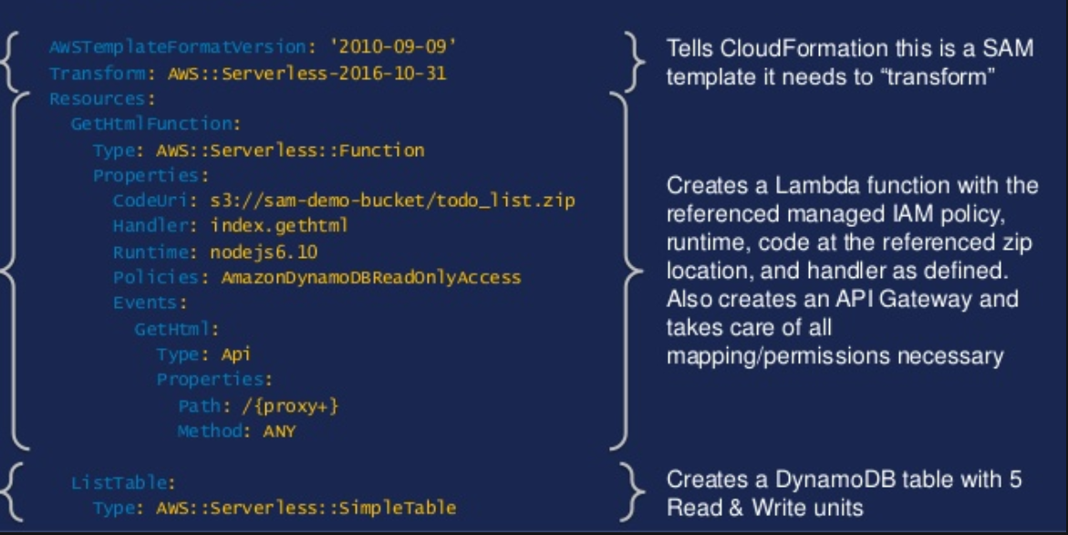
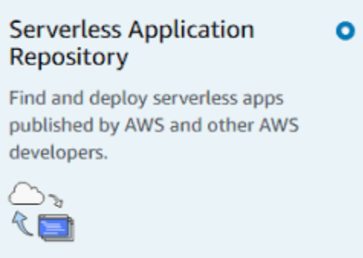
SAM Template
◼ Specific to AWS provider.
◼ Allows testing of Lambda and
API gateway locally.
◼ Automatically deploys and
configures IAM.

Slide 6
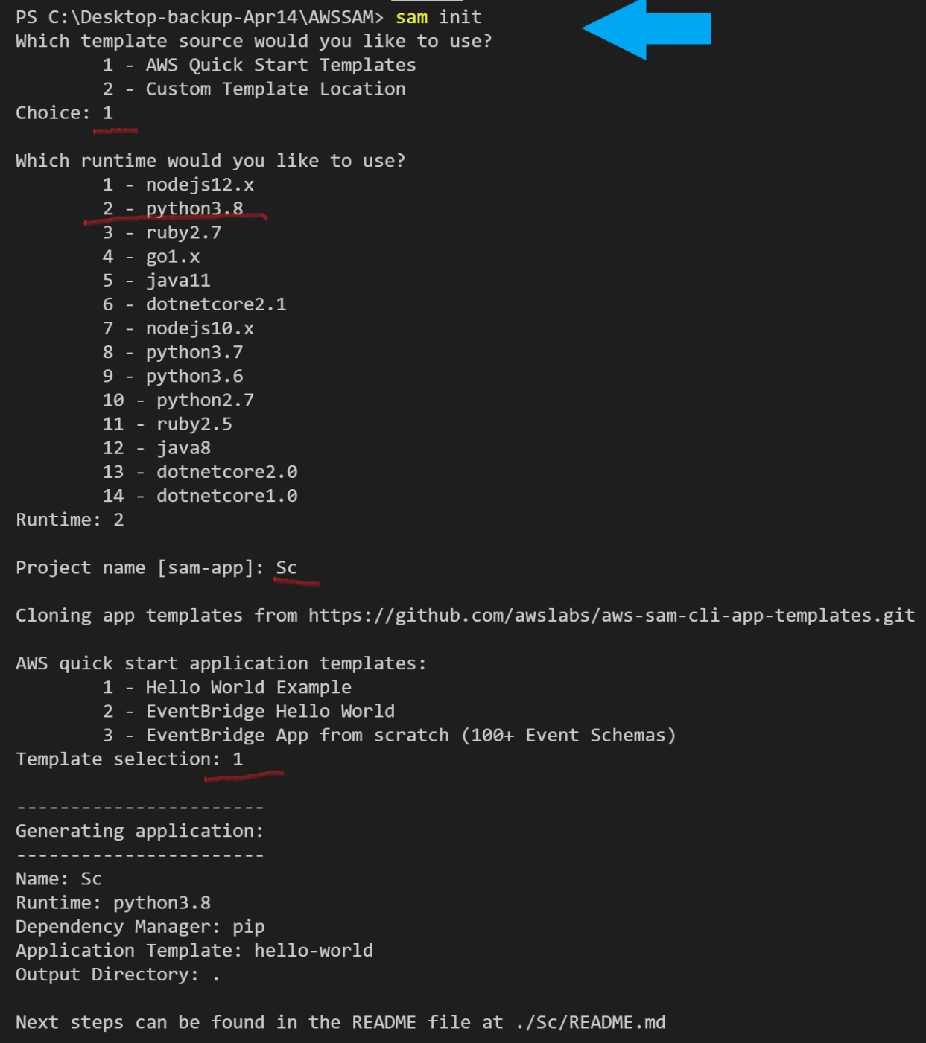
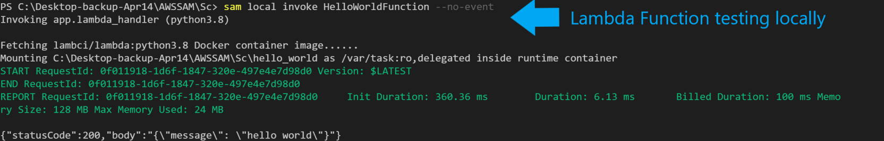
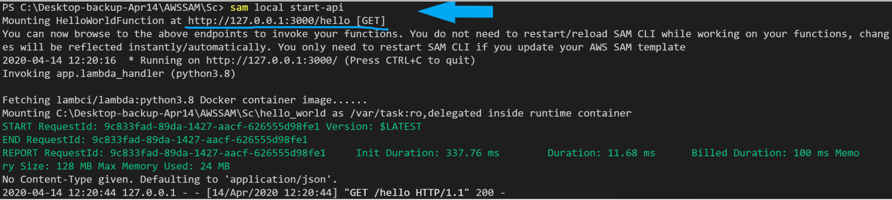
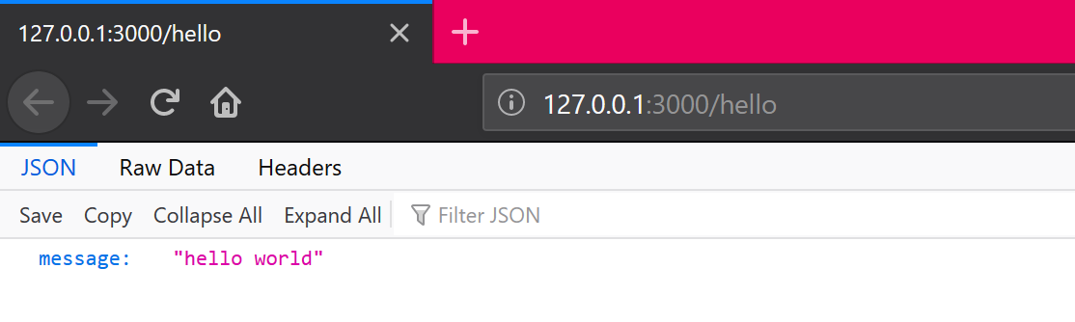
SAM Commands

Slide 7

Getting started...
Install and configure the SAM CLI.
Create an AWS serverless application using SAM CLI.
Craft the .gitlab-ci.yml file.
Set up your AWS credentials in your GitLab account.
Test locally.
Deploy your application.
Test your deployment.

Slide 8
AWS Serverless Application Model (SAM)
Specific to AWS provider.
Prerequisites :
AWS CLI
SAM CLI
Docker
Allows testing of Lambda and API gateway locally.
Commands
sam init --runtime python3.7
sam local invoke lambdafnname --no-event
sam local start-api
sam package --template-file template.yaml --output-template-file deploy.yaml --s3-bucket bucket-name
aws cloudformation deploy --template-file path --stack-name stackname --capabilities CAPABILITY_IAM

Slide 9

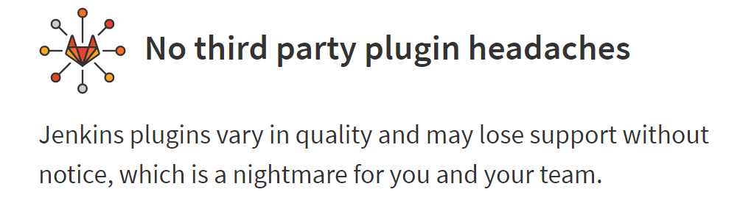
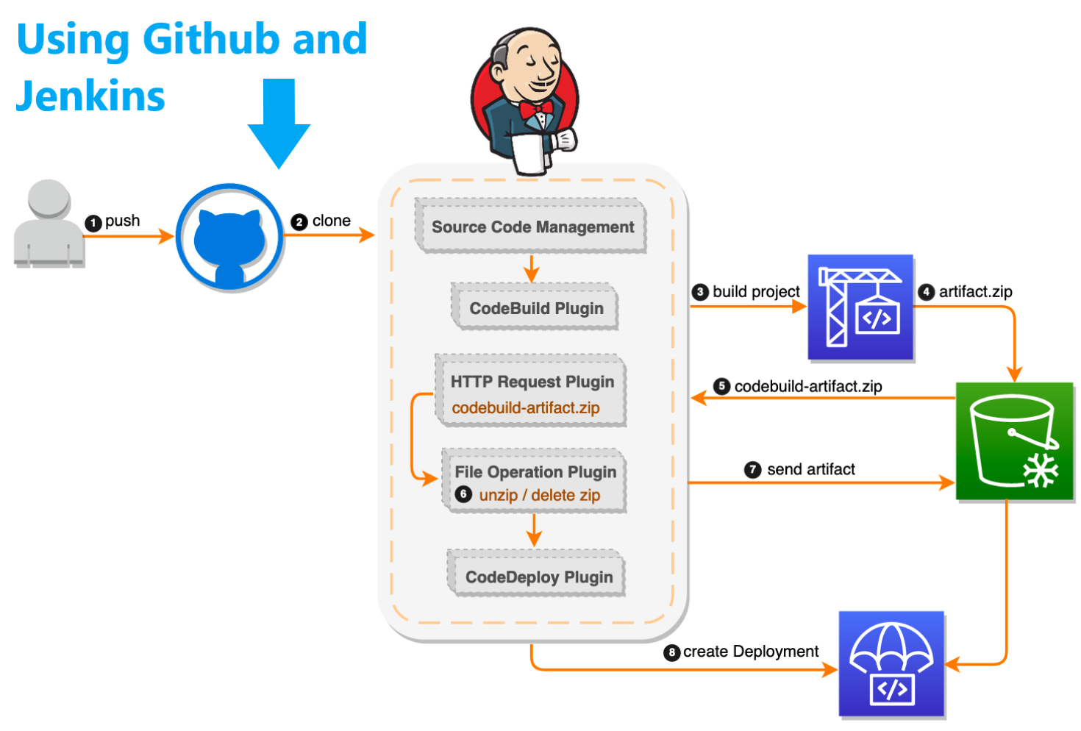
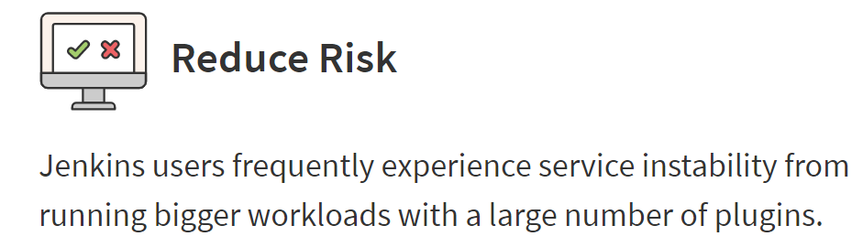
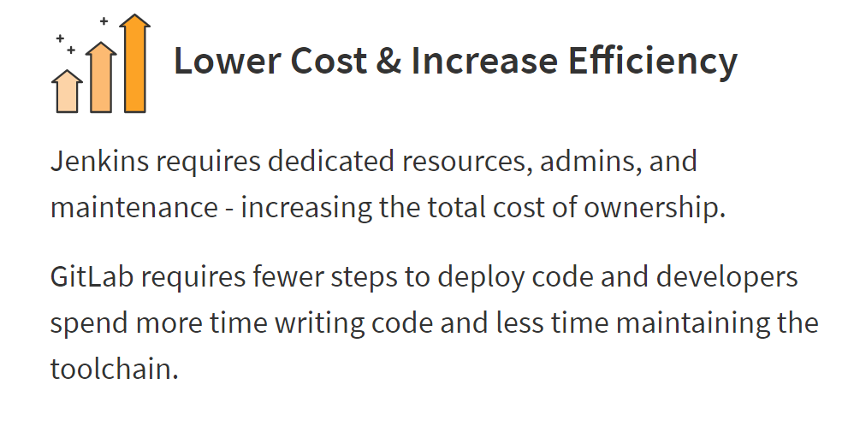
GitLab

Slide 10
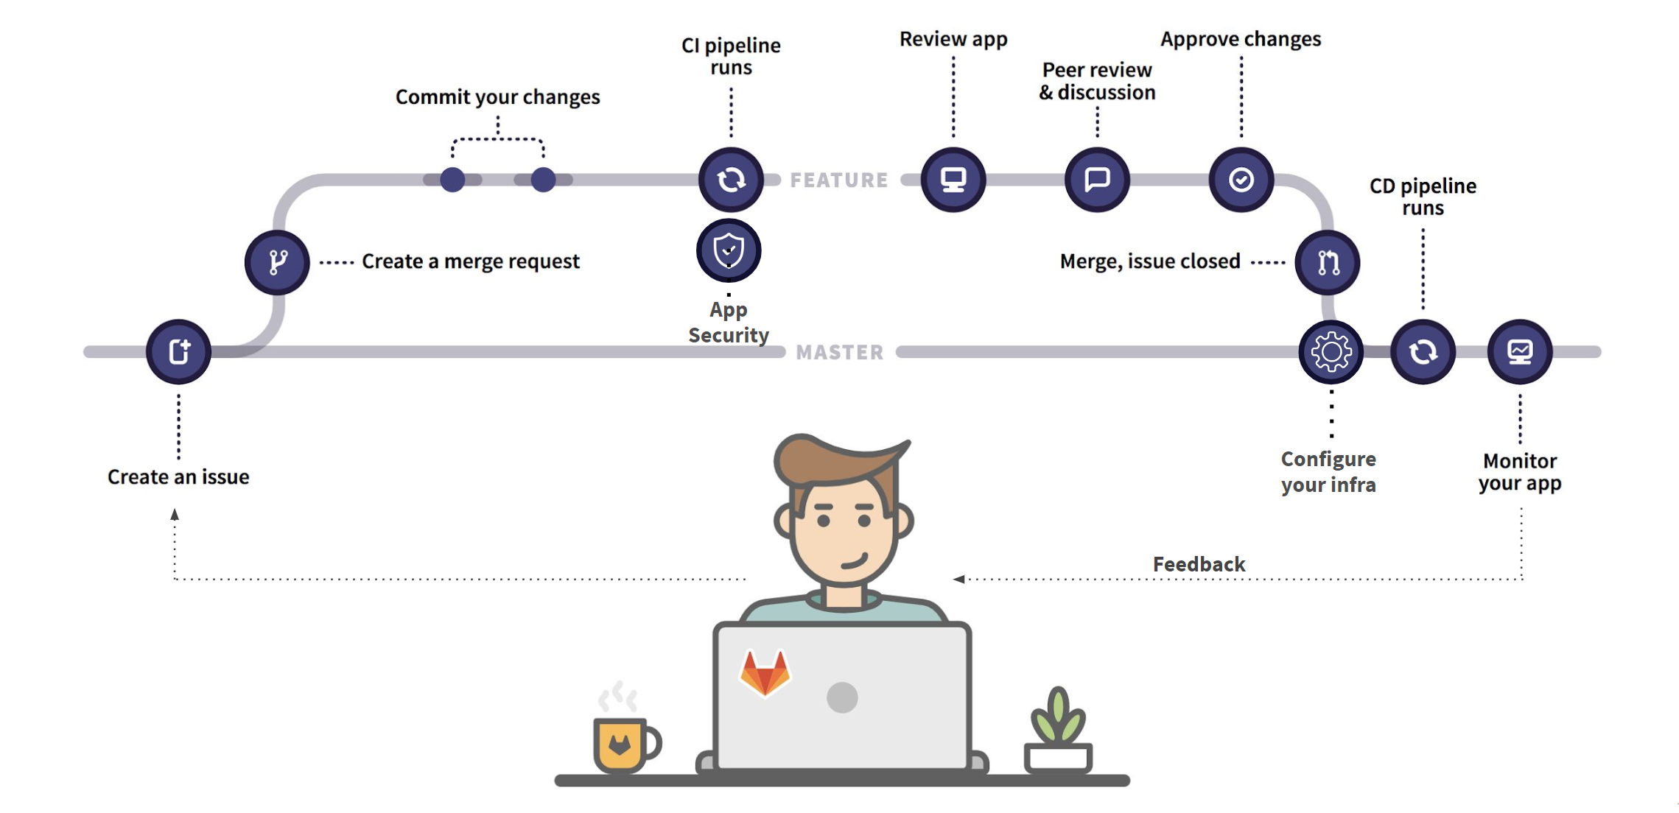
CI/CD Pipeline in GitLab
.gitlab-ci.yml file defines sets of jobs with constraints of how and when they should be run.
Push the .gitlab-ci.yml to your GitLab repository.
In GitLab, Runners run the jobs that you define in .gitlab-ci.yml
On any push to your repository, GitLab will look for the .gitlab-ci.yml file and start jobs on Runners according to the contents of the file, for that commit.

Slide 11

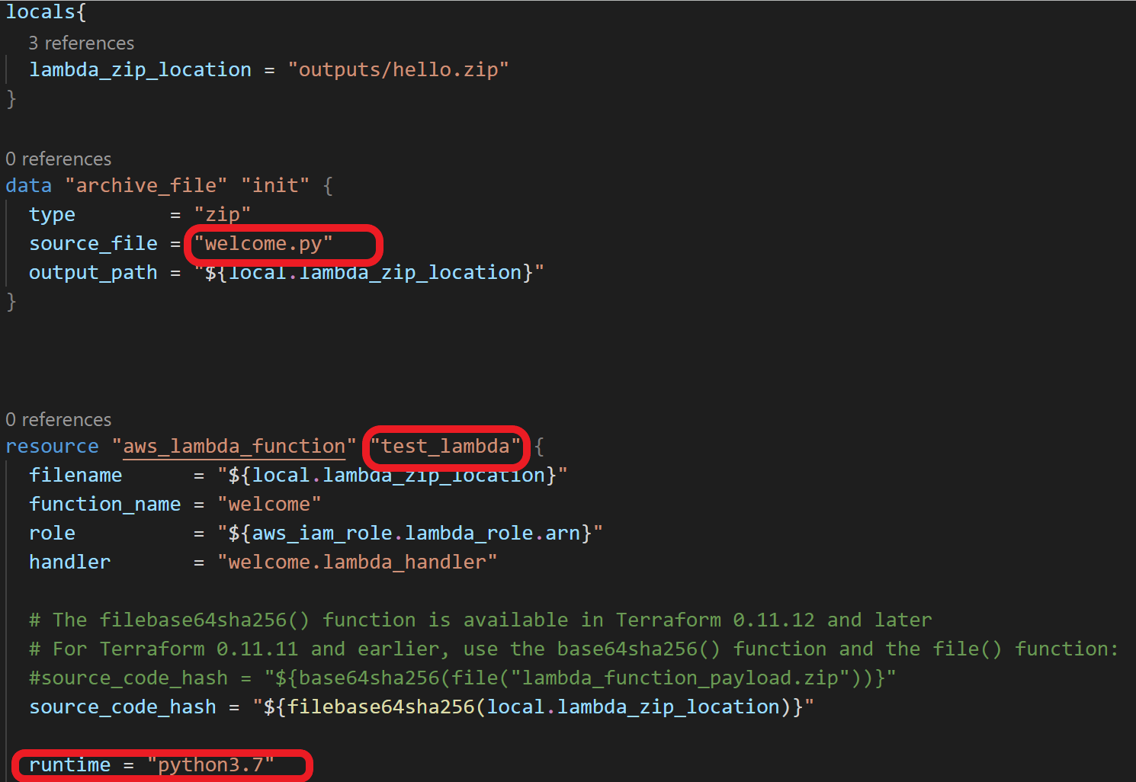
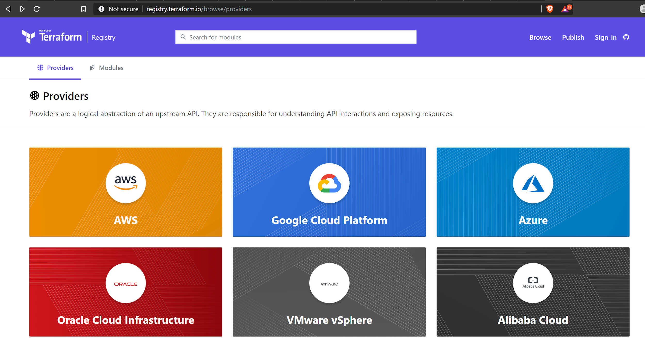
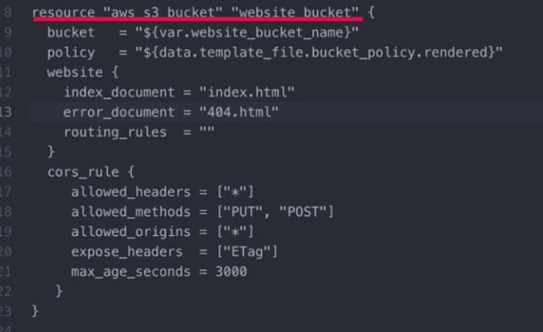
Terraform
Open Source Project from HashiCorp.
Multi-Cloud support(AWS, Azure, GCP etc).
Multiple providers and services to be combined.

Slide 12
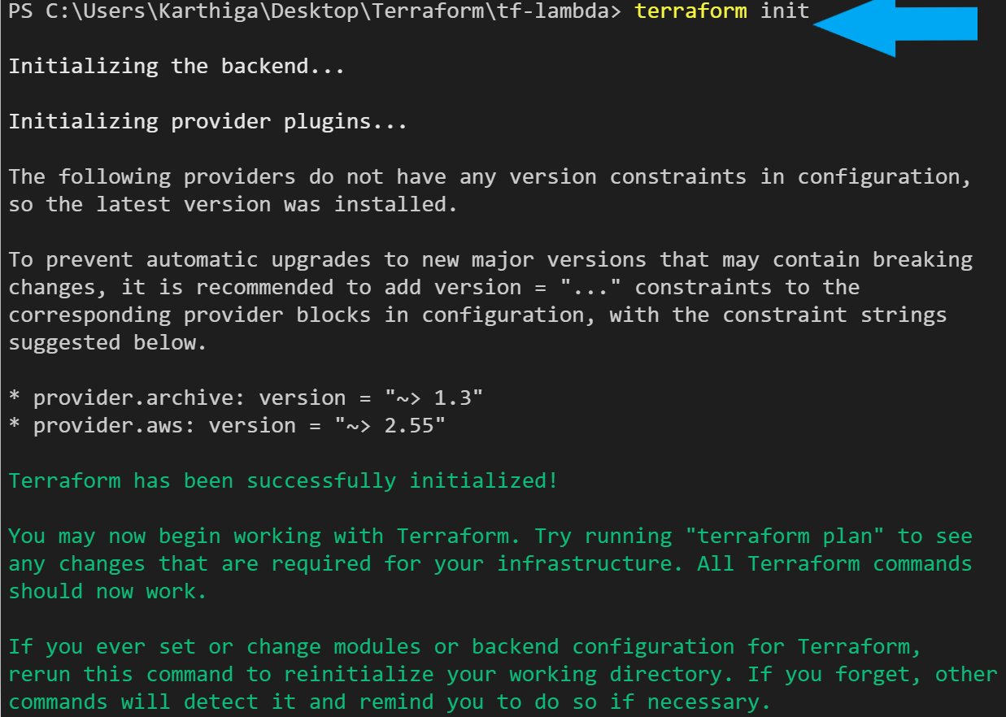
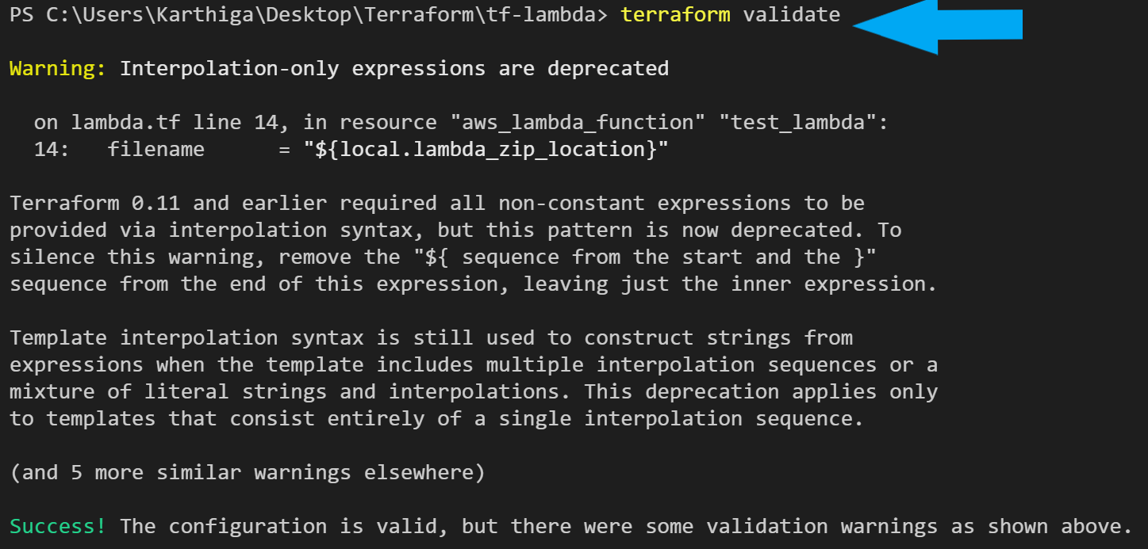
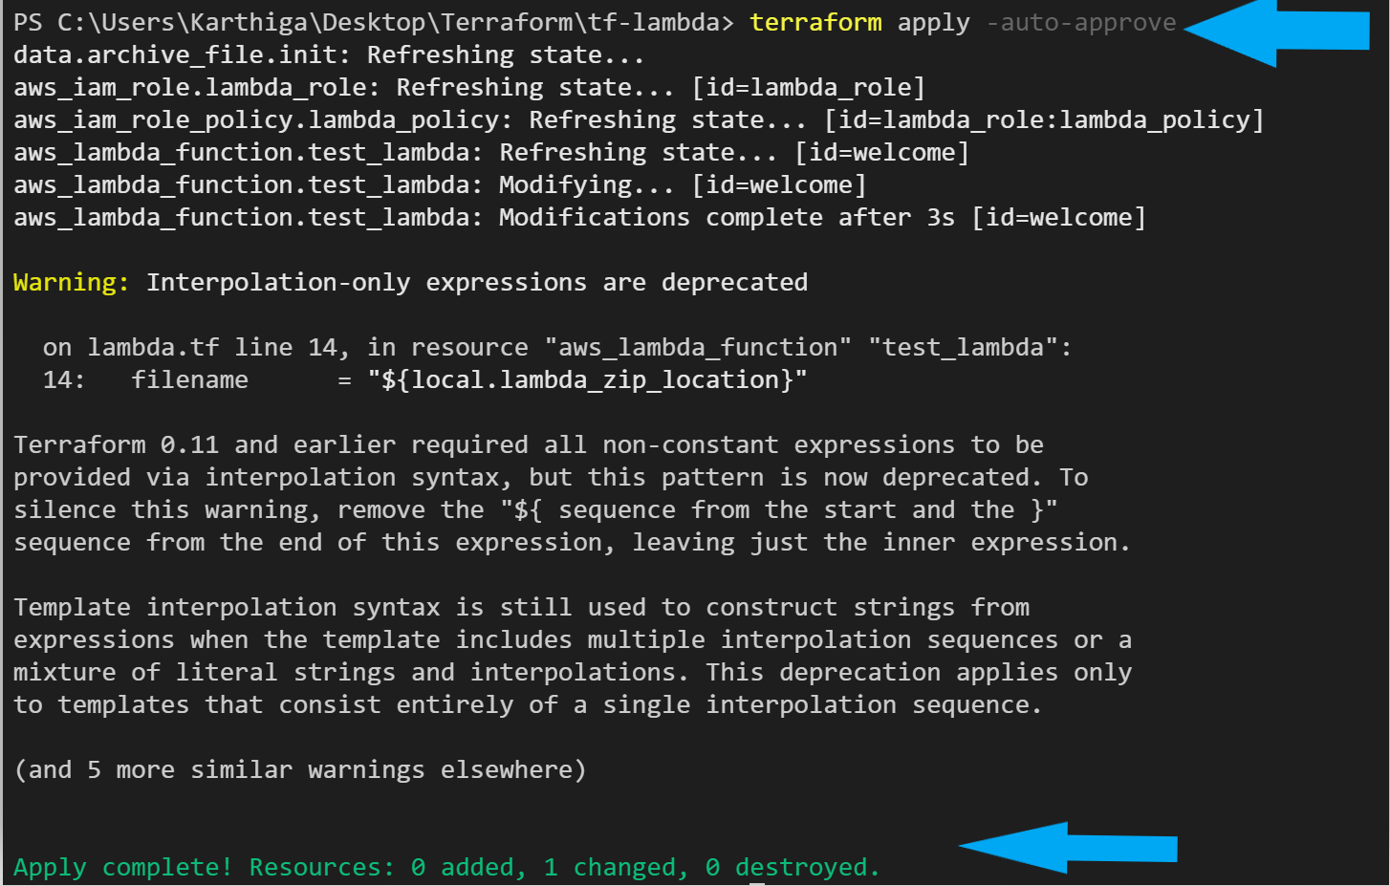
Terraform Commands

Slide 13
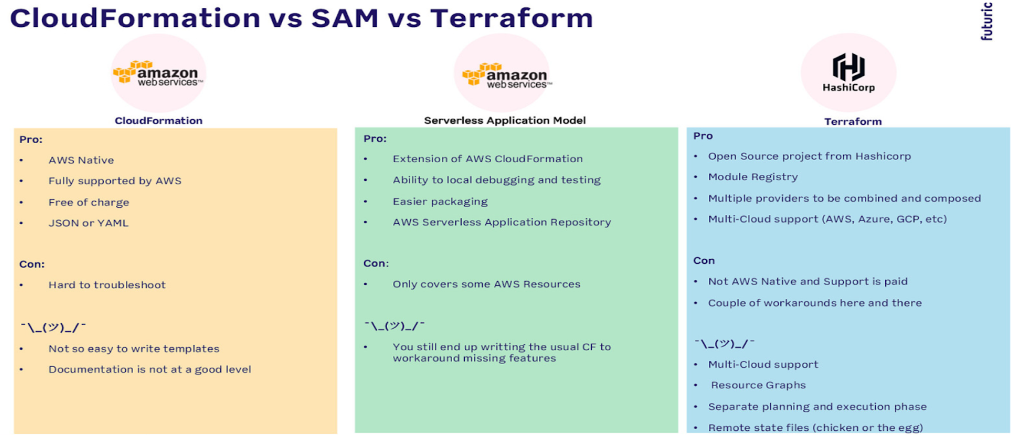
Comparison

Slide 14
Serverless Sagemaker
Orchestration Demo

Slide 15
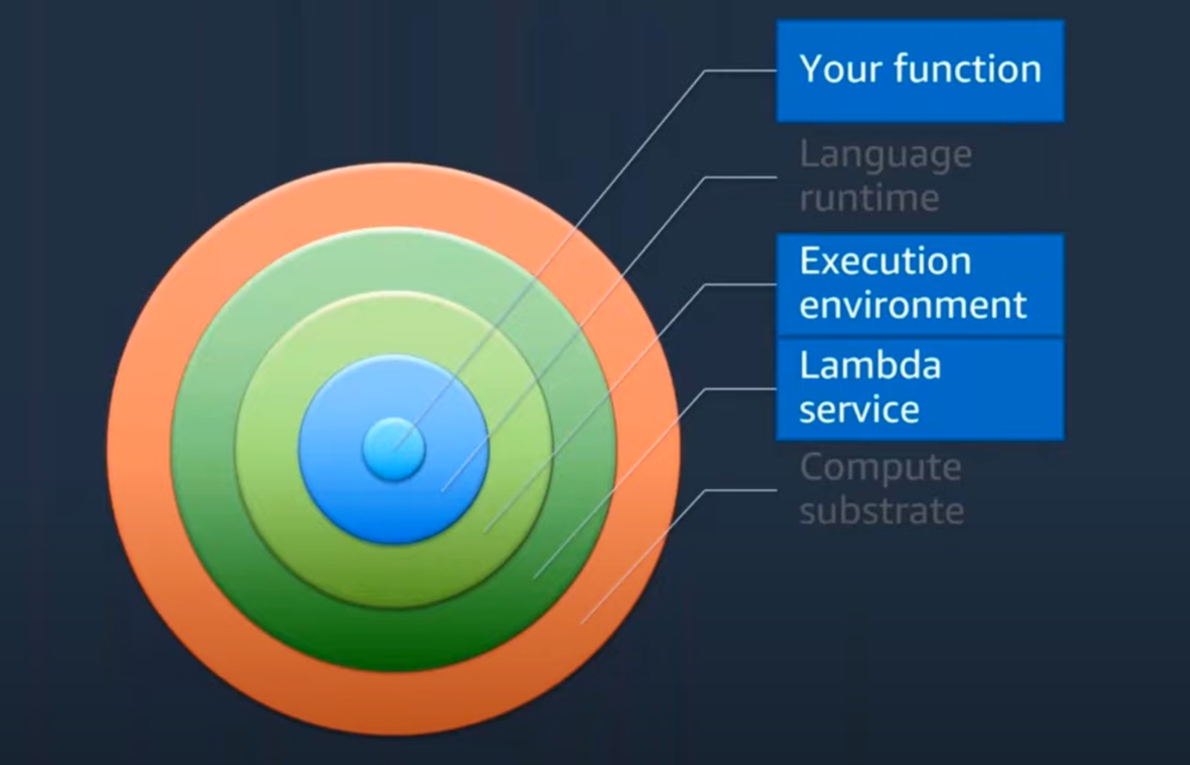
Anatomy of a Lambda Function

Slide 16
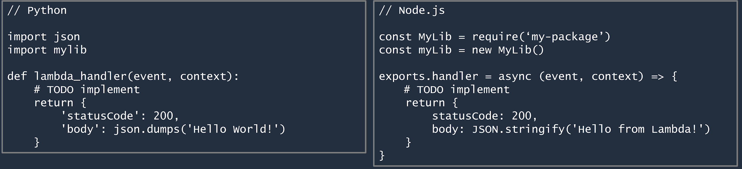
Anatomy of a Lambda Function
Handler()Function
Function to be executed upon invocation
Event Object
Data sent during lambda function invocation
Context Object
Methods available to interact with runtime information (Request ID, Log group, …)

Slide 17
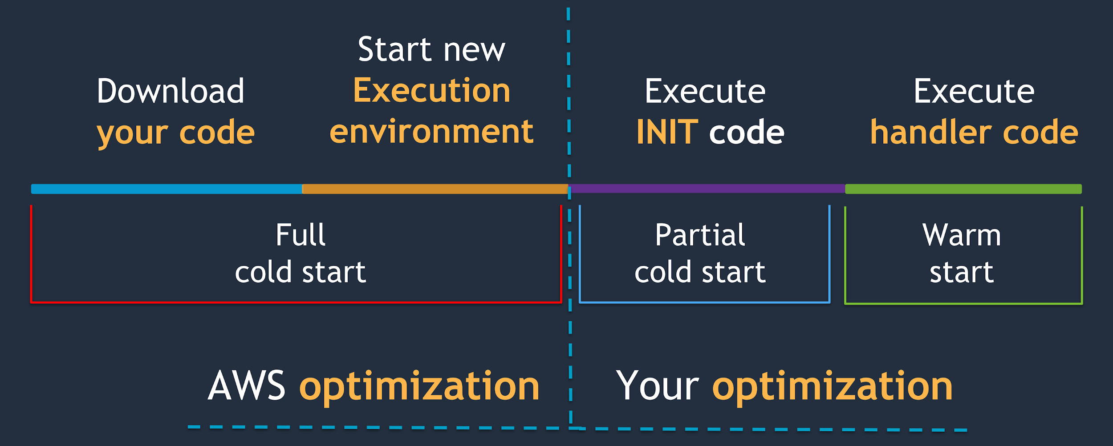
The Function Lifecycle

Slide 18
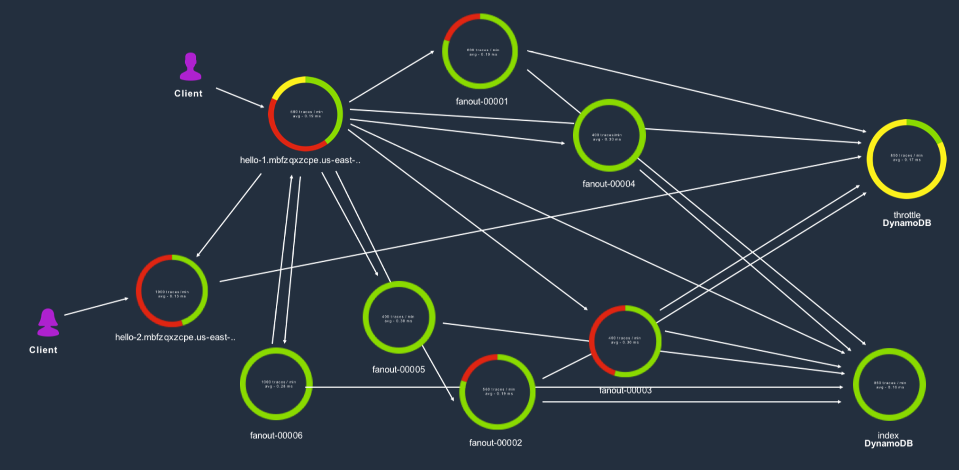
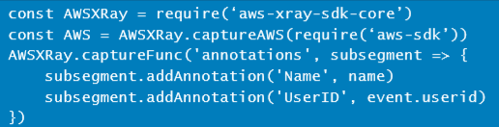
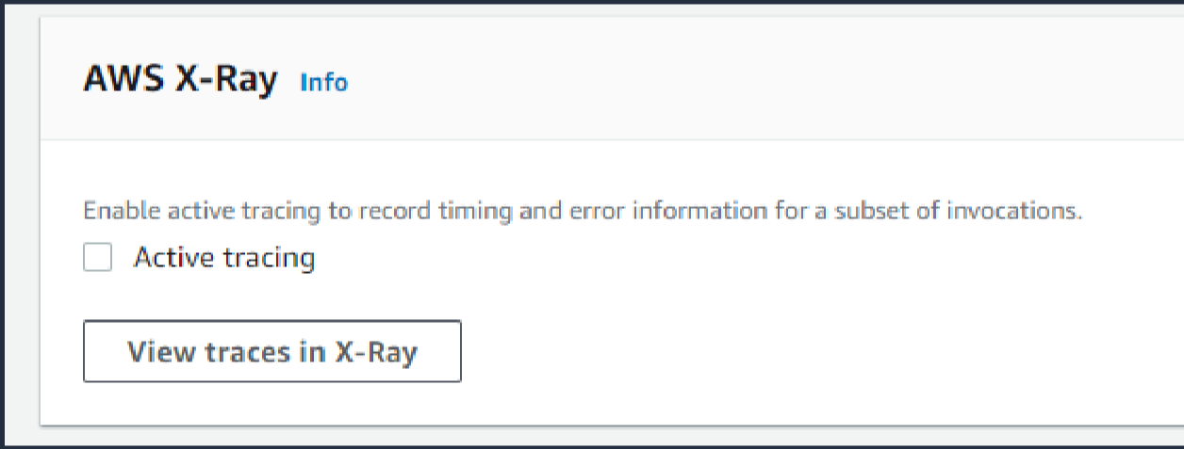
Measuring With AWS X-Ray
Profile and troubleshoot serverless applications:
Lambda instruments incoming requests and can capture calls made in code
API gateway inserts tracing header into HTTP calls and reports data back to X-Ray

Slide 19
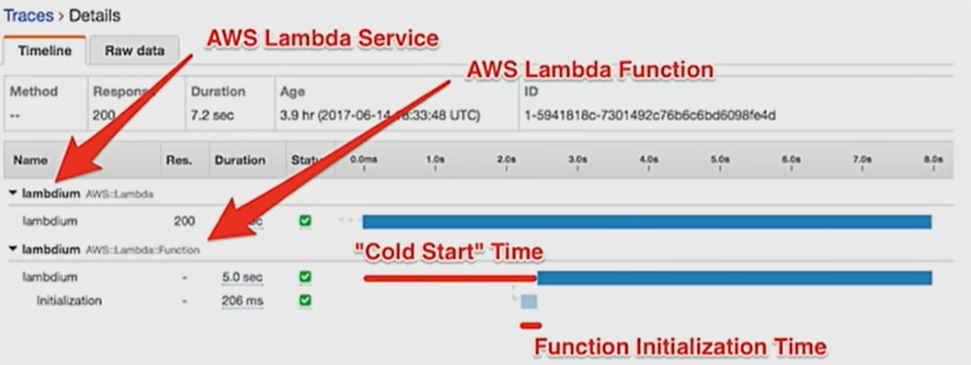
X-Ray Trace Example

Slide 20
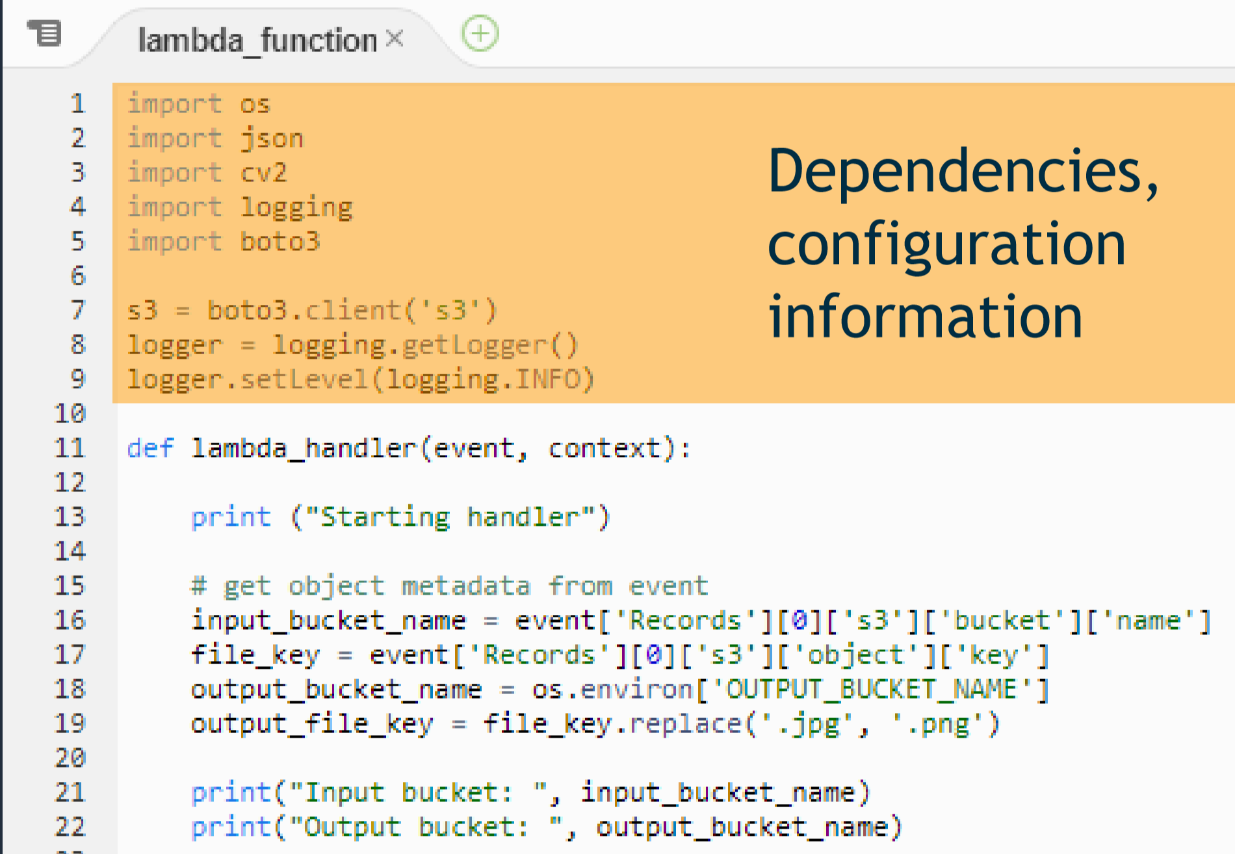
Cold Starts - static initialization
influenced by:
Size of function package
Amount of code
Amount of initialization work
What can help?
Code optimization
Import only what you need; trim SDKs
execution environments are reused
Lazily load variables
clear out used variables
Provisioned Concurrency

Slide 21
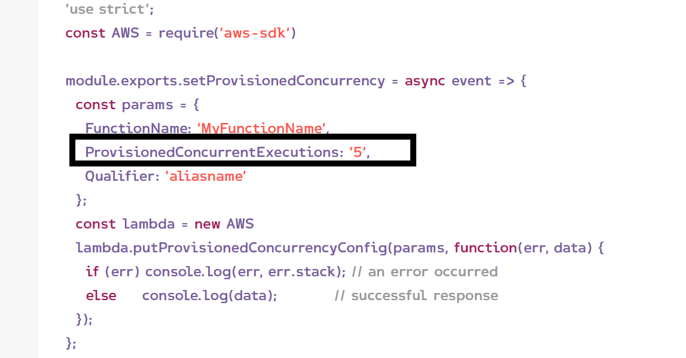
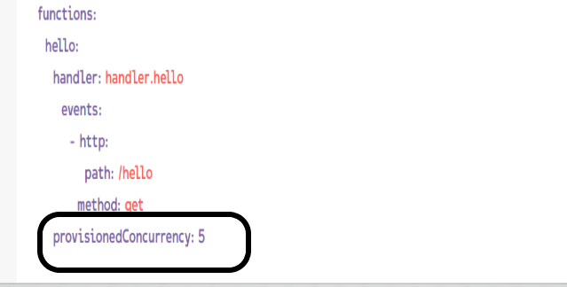
Provisioned Concurrency
◼ Lambda
First compute service with automated scaling and complete elimination of machine or container maintenance.
◼ Cold start
Process that could take 50 - 200 ms (or longer depending on the runtime you choose) before any execution actually started.

Slide 22
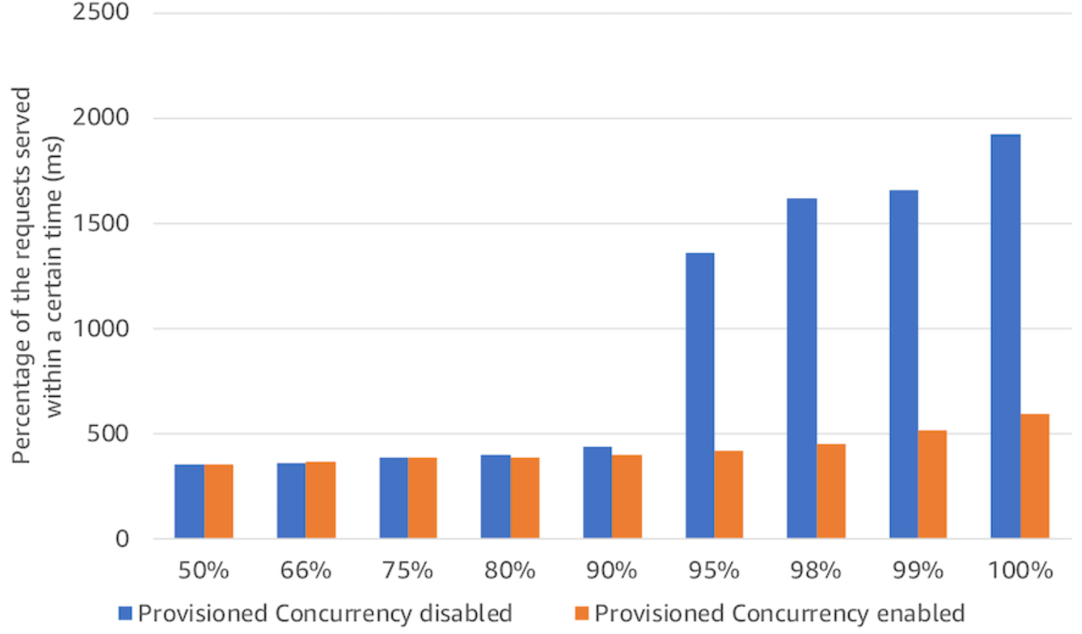
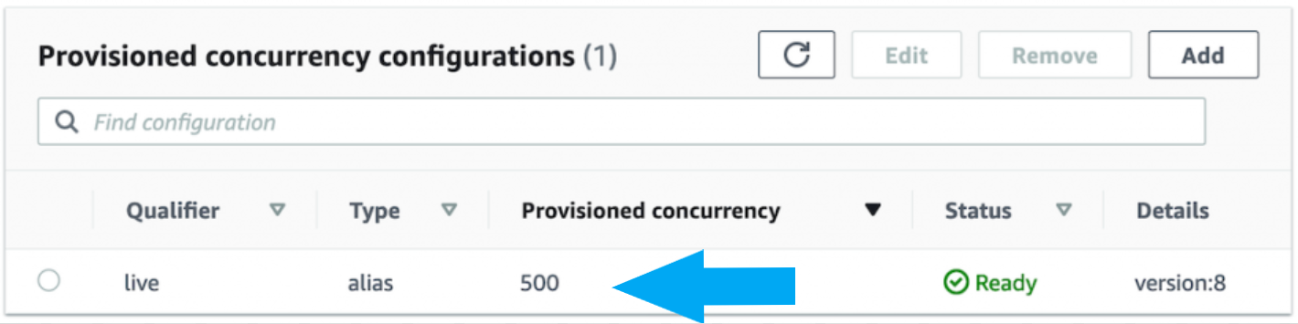
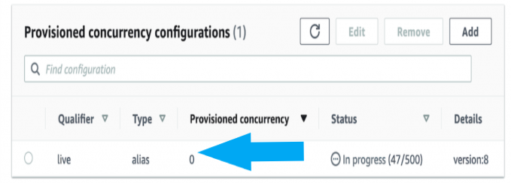
Provisioned Concurrency
Experiment:
Two Lambda functions that use the same Java code and can be triggered by Amazon API Gateway. To simulate a production workload, these functions are repeating some mathematical computation 10 million times in the initialization phase and 200,000 times for each invocation.

Slide 23
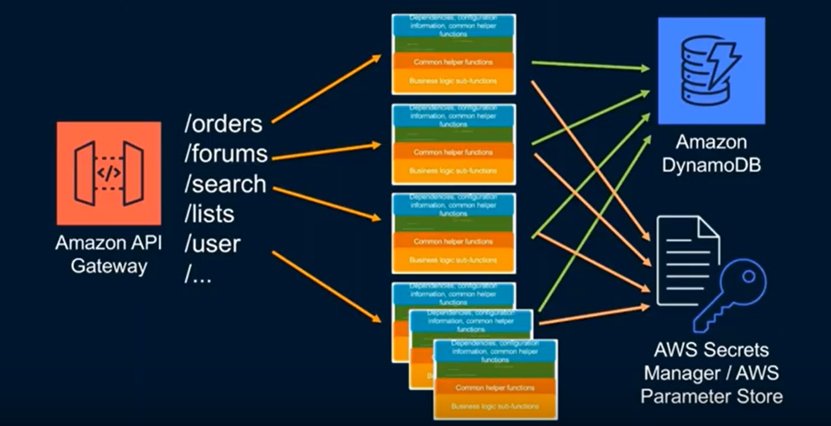
Lambda Layer
There will be a lot of duplicated code in Lambda functions here.
Lambda Layer save on code duplication.
You can have five layers and Each layer is a zip file.
Layers are immutable and can be versioned to manage updates.

Slide 24
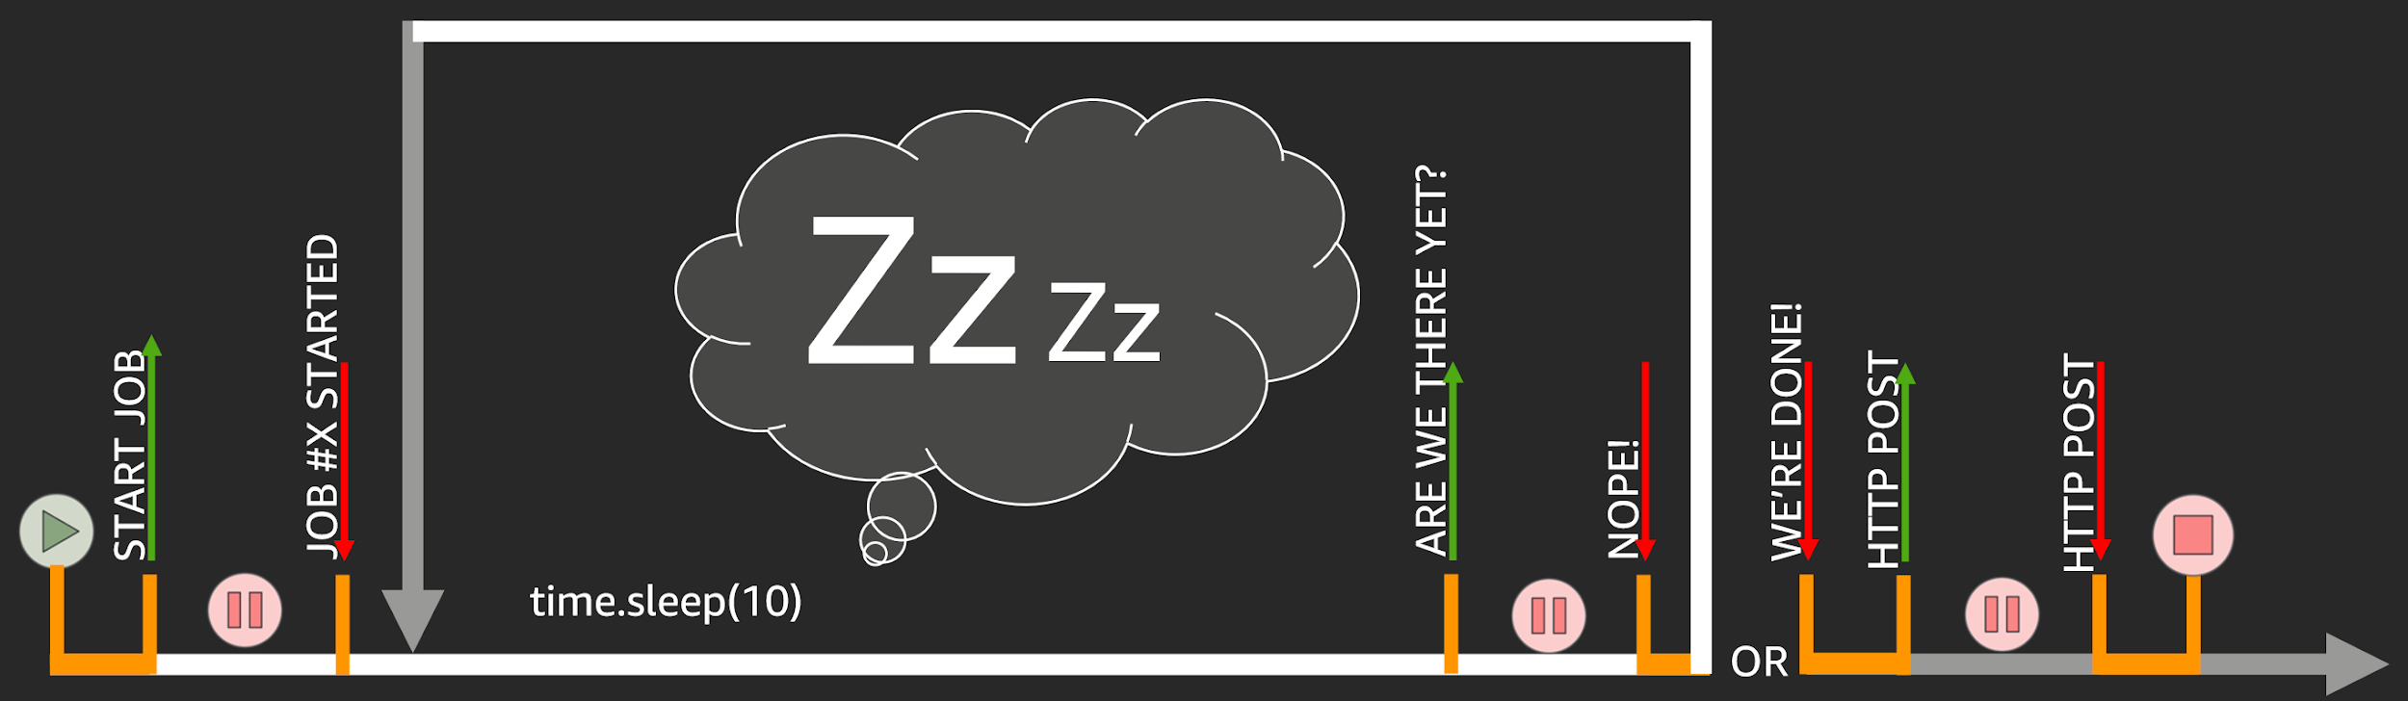
No Orchestration In Code

Slide 25
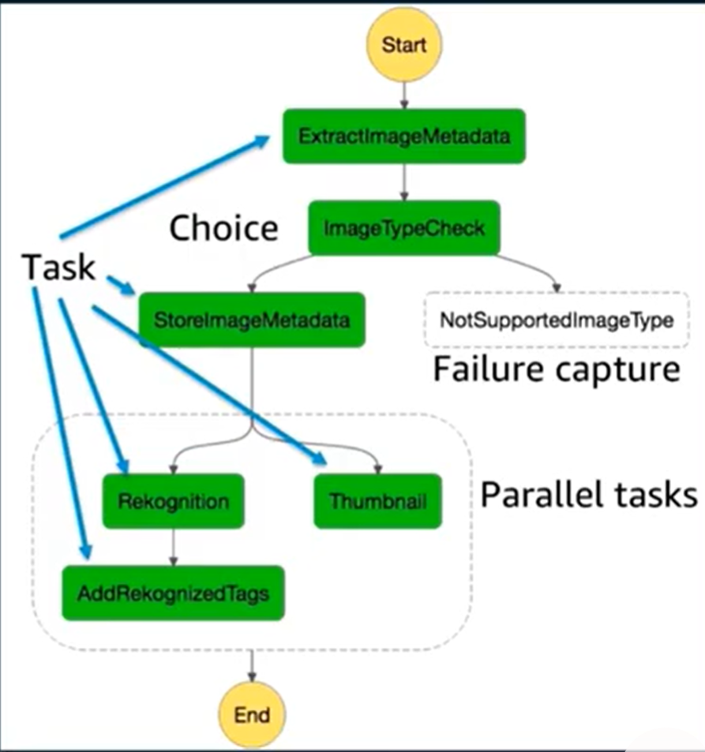
AWS Step Function
Serverless workflow management with zero administration:
Make it easy to coordinate the components of distributed applications and microservices using visual workflow
Logs the state of each step, so when things do go wrong, you can diagnose and debug problem quickly

Slide 26
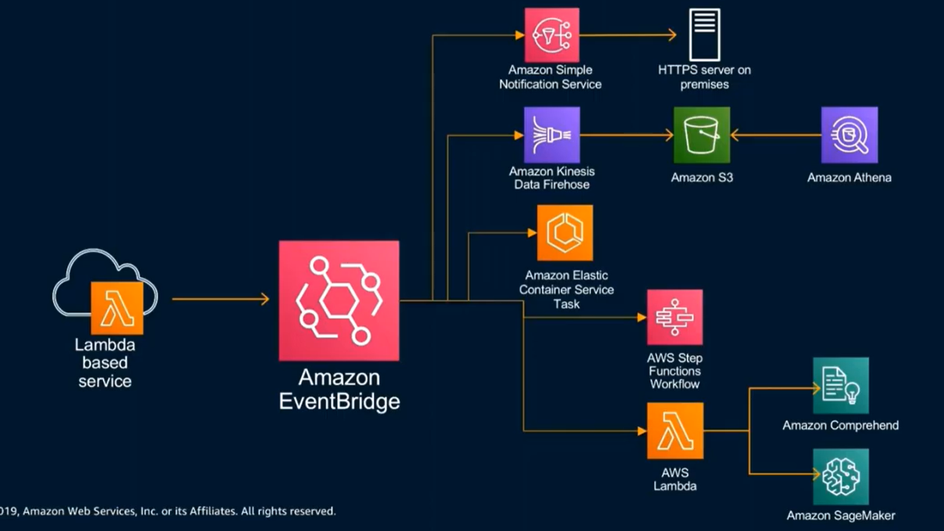
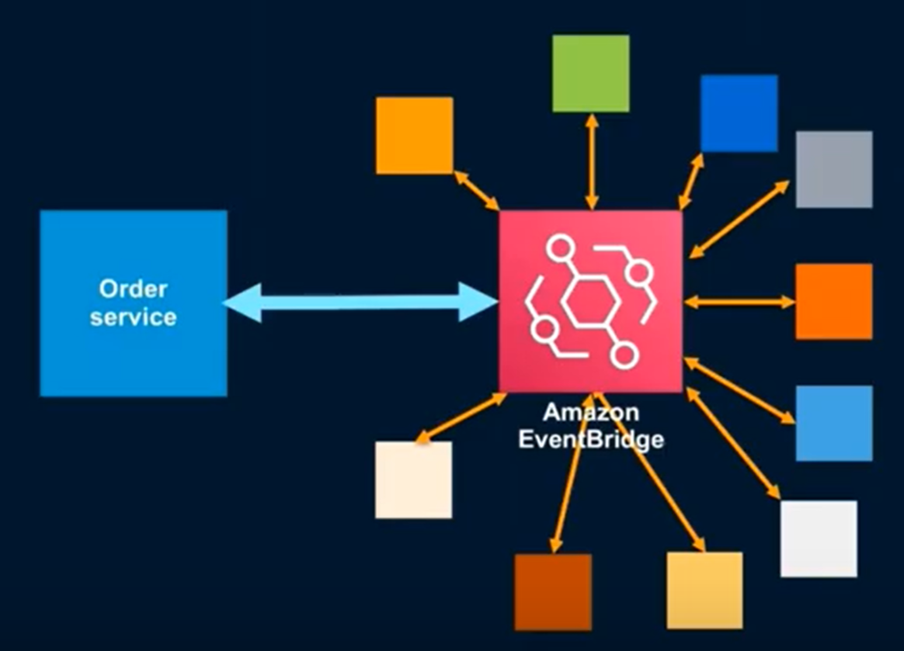
Event passing with AWS EventBridge
use Lambda functions to Transform not Transport
For AWS EventBridge, services don’t need to know about each other, only about the bus.
Services can both produce massages on to the bus and consume just the massages they need from the bus.

Slide 27
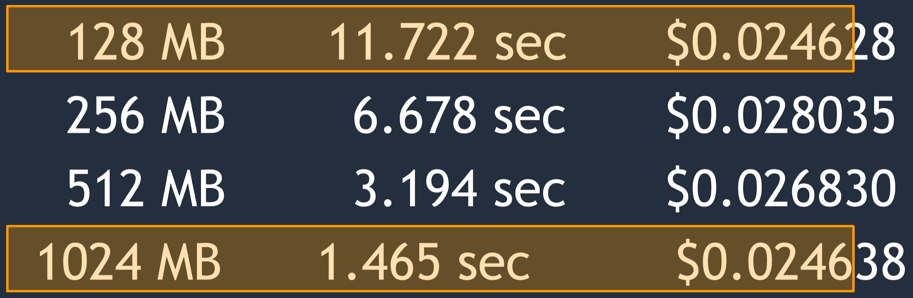
CPU-bound Example
“Compute 1,000 times all prime numbers smaller than 1M”
more memory ⇒ more CPU and I/O ⇒ save time and money
match resource allocation (up to 3GB)
<1.8GB is single core.
>1.8 GB is multicore. CPU bound workloads will gains, but need to multithread. I/O bound workloads will see gains.

Slide 28
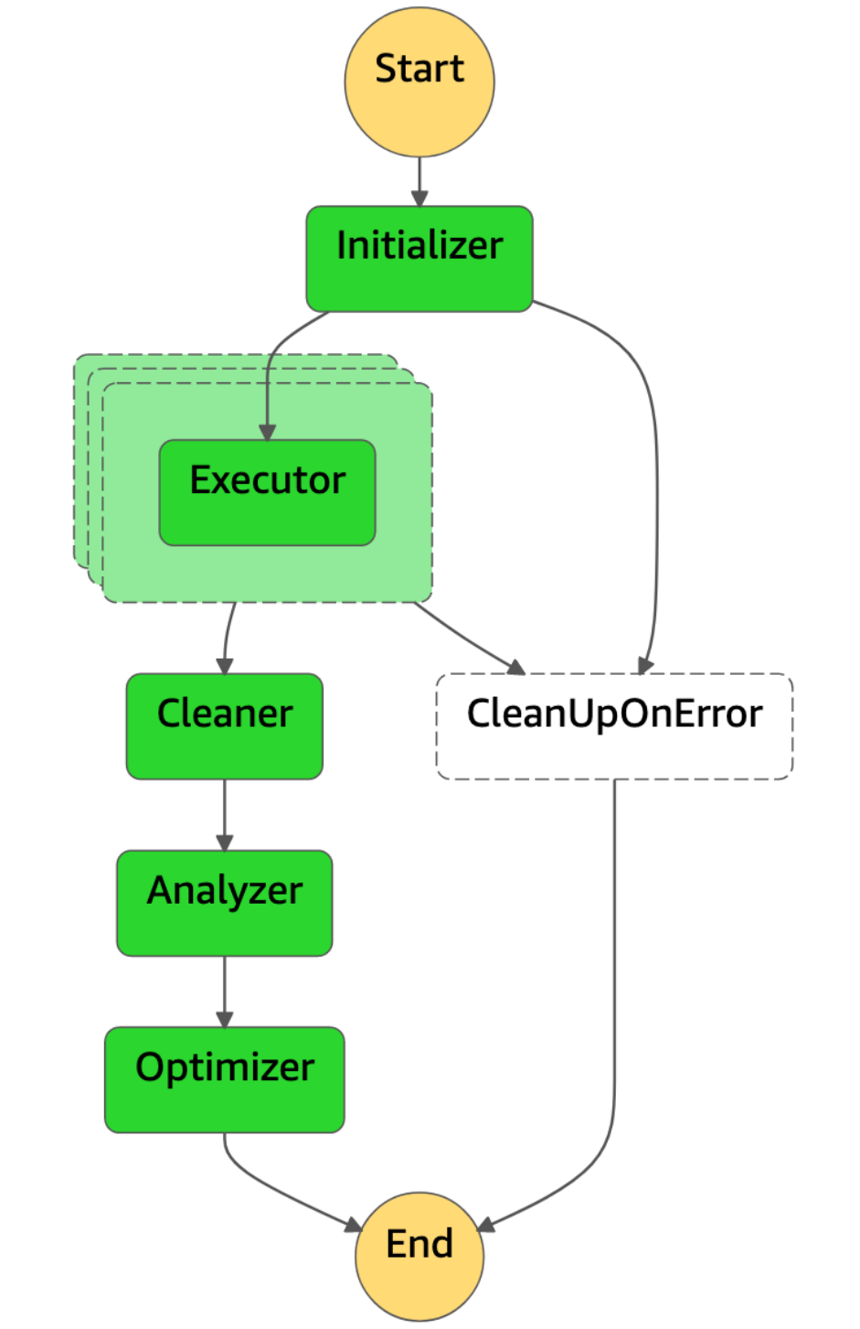
AWS Lambda Power Tuning
Features:
Data-driven cost and performance optimization for AWS Lambda
available as an AWS serverless application repository app
Easy to integrate with CI/CD

Slide 29
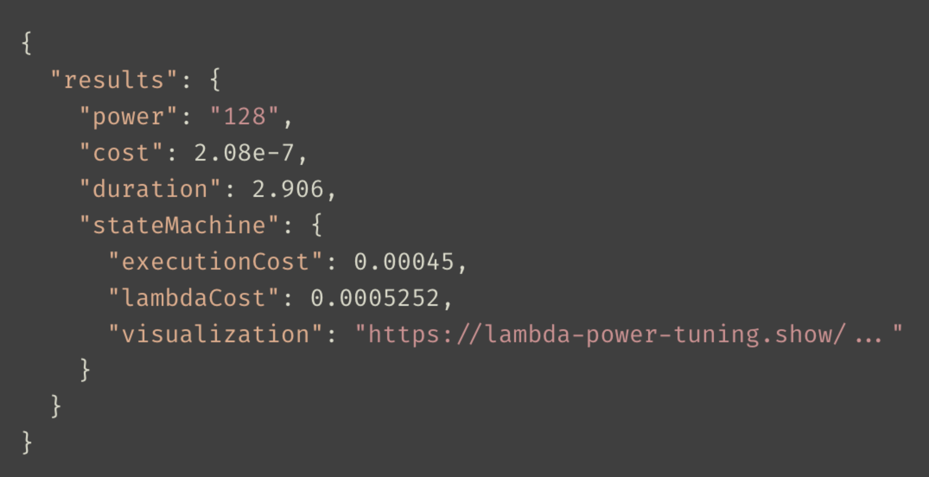
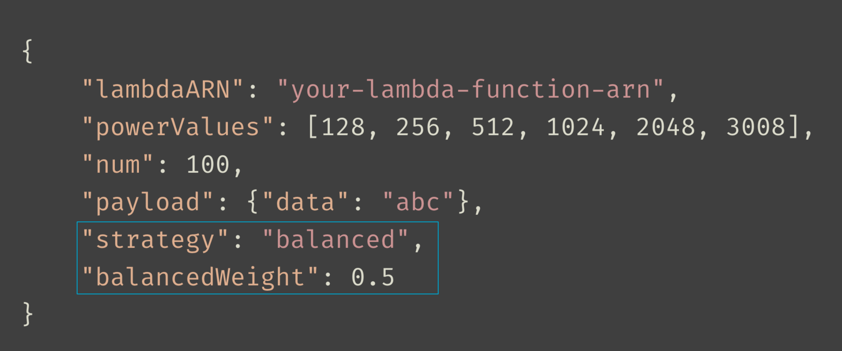
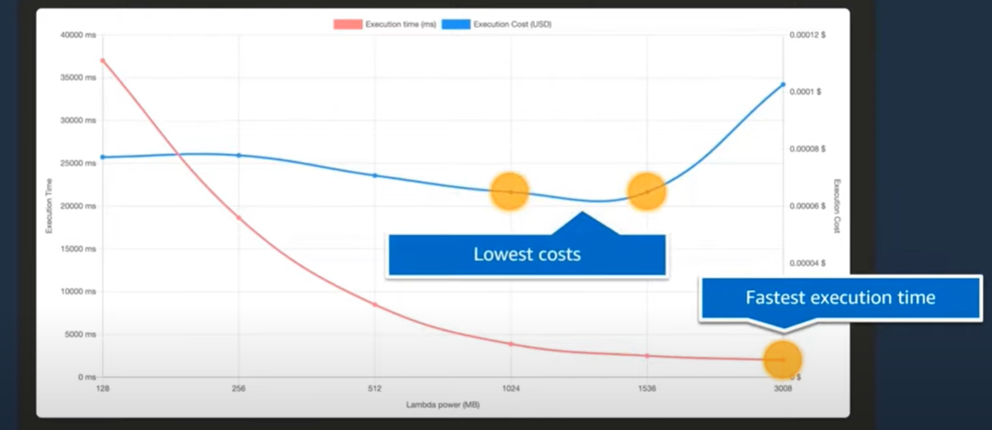
AWS Lambda Power Tuning
Output and visualization
input

Slide 30
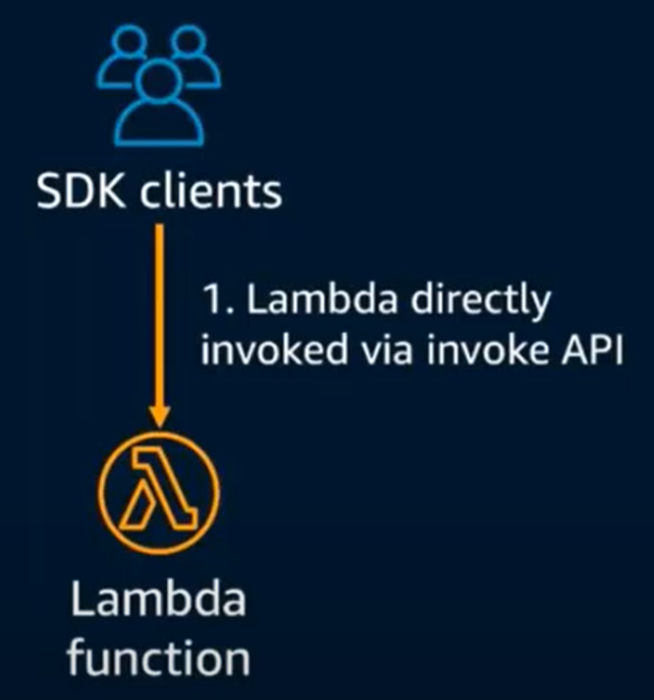
Lambda API
API provided by the lambda services
Used by all other services that invoke lambda across all models
Support sync and async
can pass any event payload structure you want
client include in every SDK

Slide 31
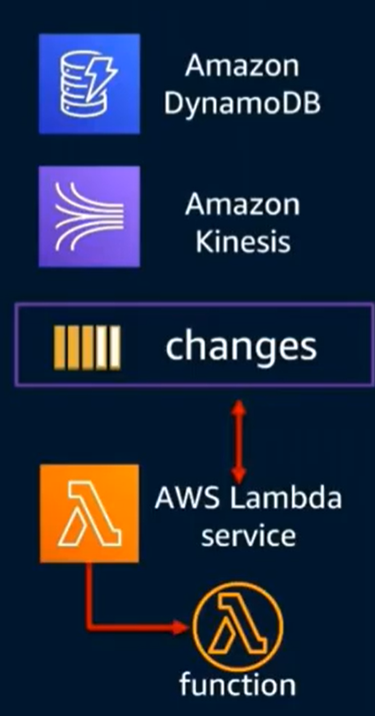
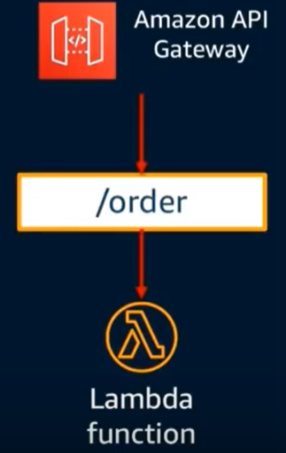
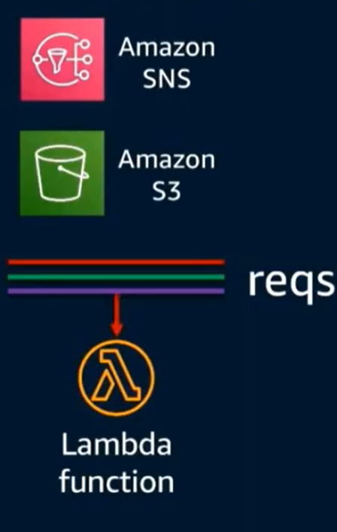
Lambda Execution Model
Synchronous(push)
Asynchronous(event)
Stream (poll-based)

Slide 32
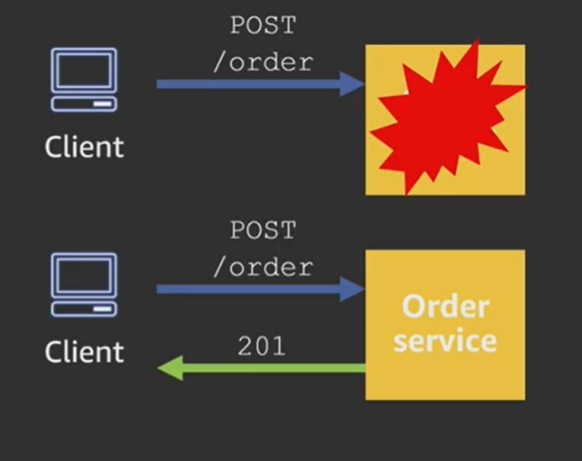


Synchronous API
retry after failure

Slide 33

Asynchronous API

Slide 34

Asynchronous Execution
If you don’t need a response, use the Lambda APIs to start an asynchronous execution
Build-in queue (SQS behind the scenes)
Automatic retries
Dead letter queue for failed events

Slide 35

Lambda Event Destination
For asynchronous invocations, capture success or failure.
record contains details about the request and response in JSON format
contains more information than data sent to a DLQ
can send both outcomes to same destination or can send success to one destination, failure to another

Slide 36



Solution for API Gateway Limit Time
AWS API gateway has a max timeout of 30 Sec.
implementing an asynchronous model
initial request/response
background processing
polling

Slide 37







Comparing Serverless Architecture Providers

Slide 38



